Slide 1
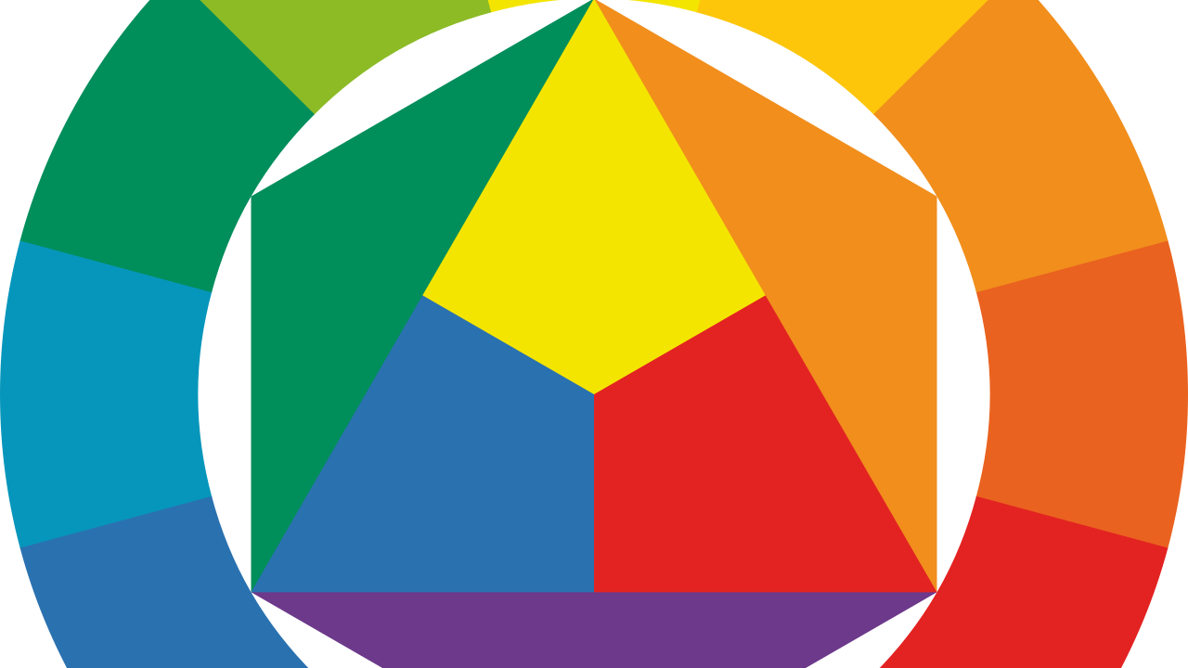
Color Theory

Slide 2
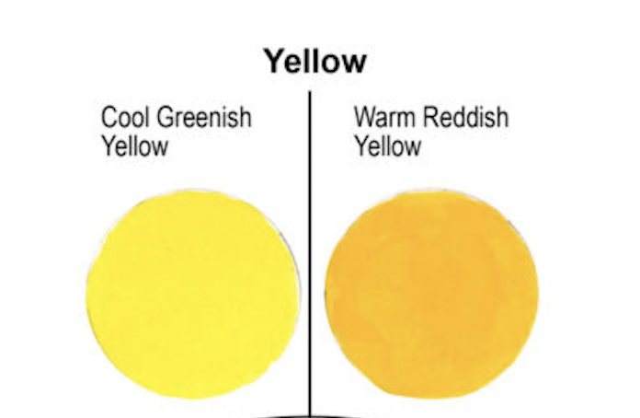
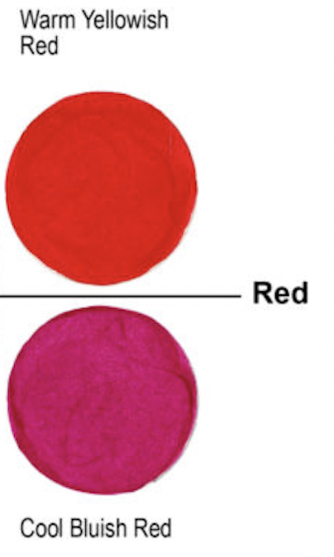
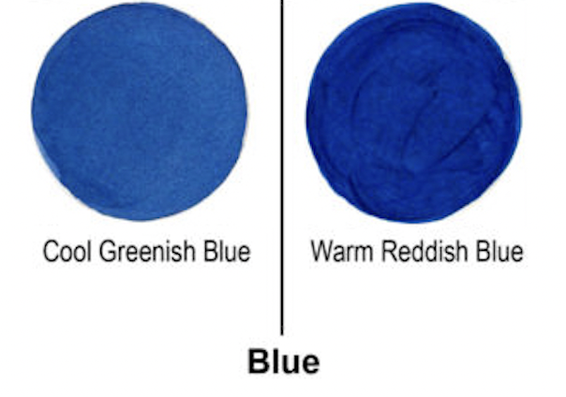

Slide 3

Primary/permanent Blue

Slide 4
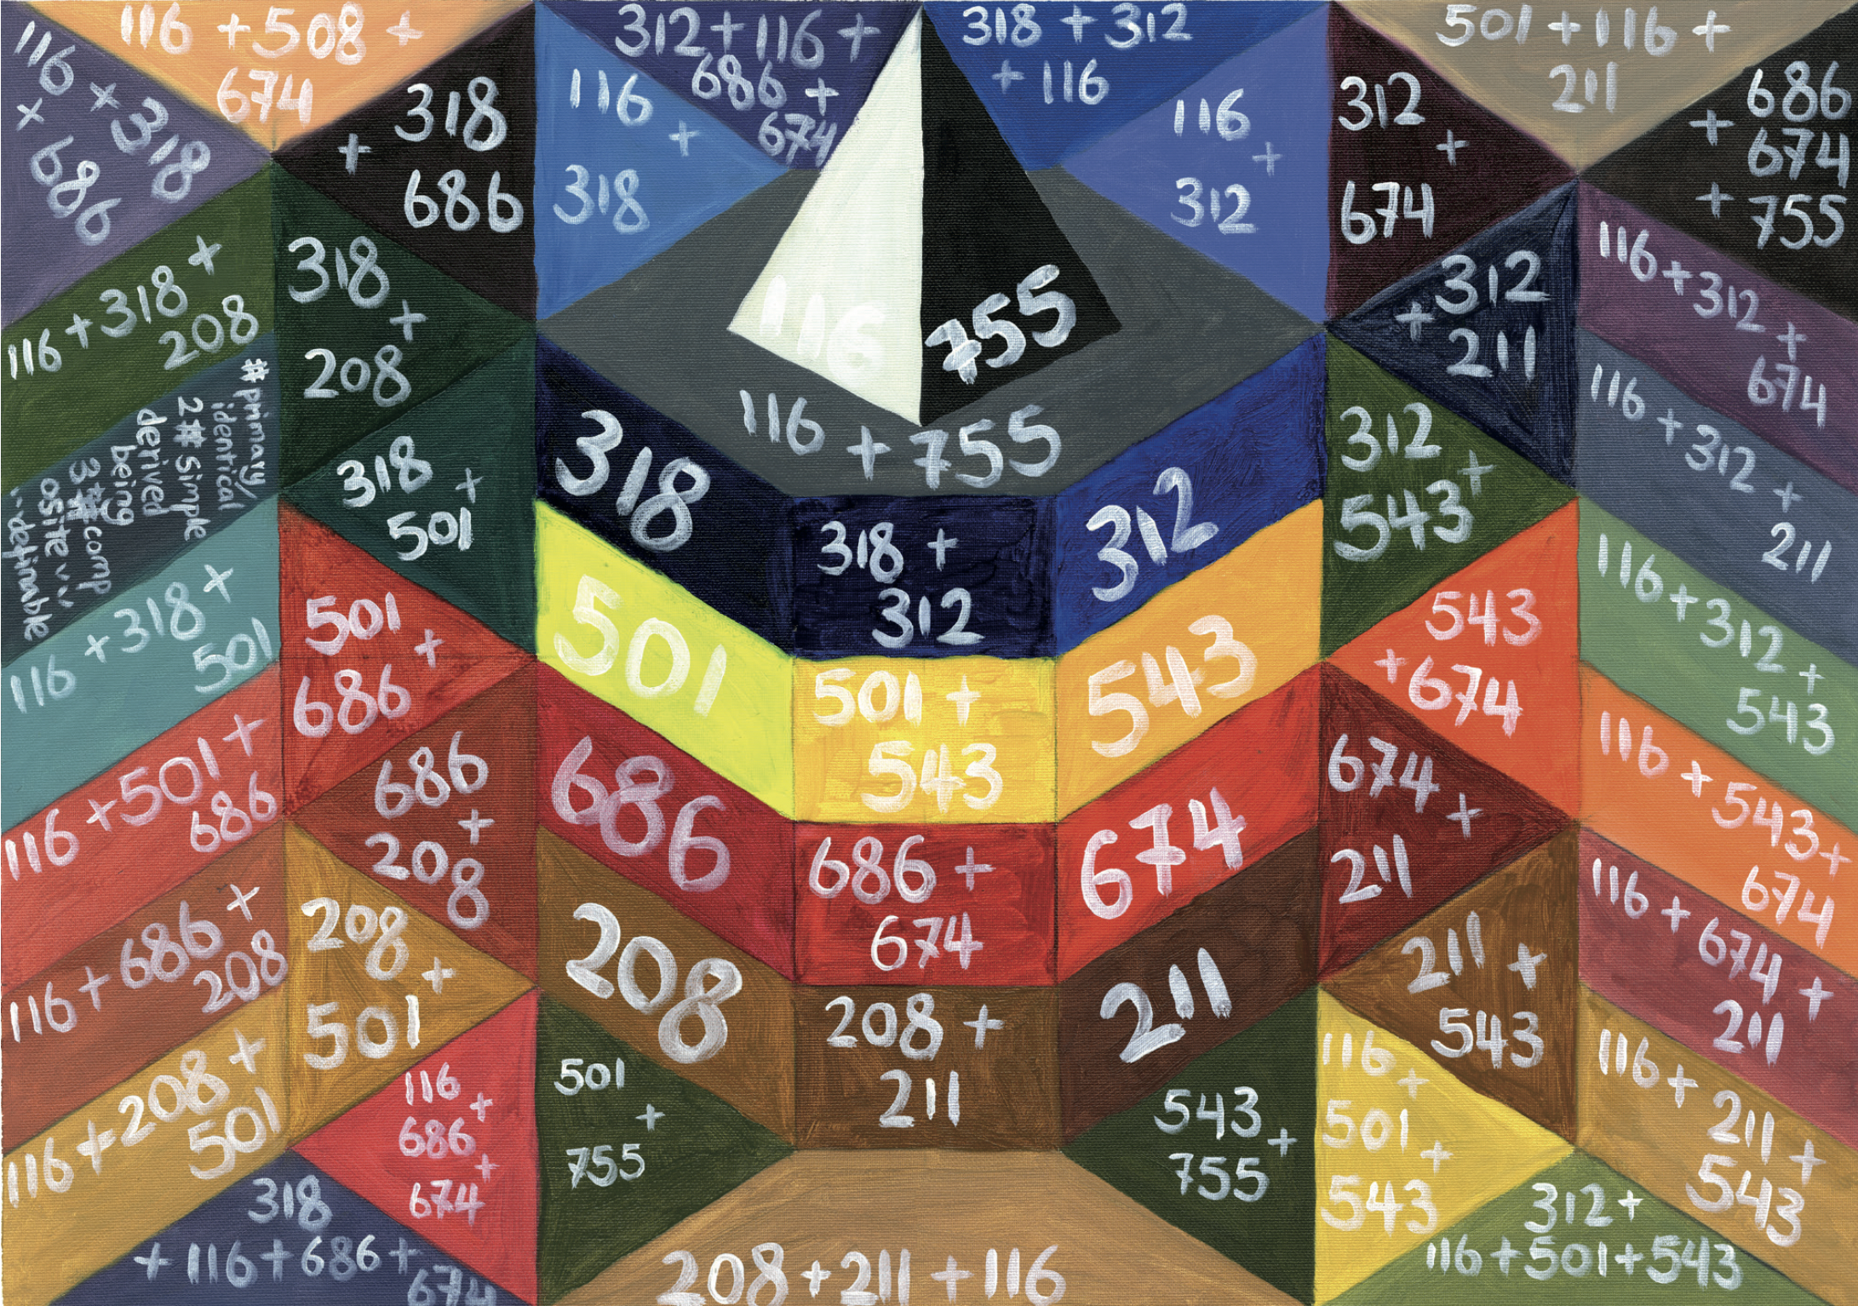

Slide 5

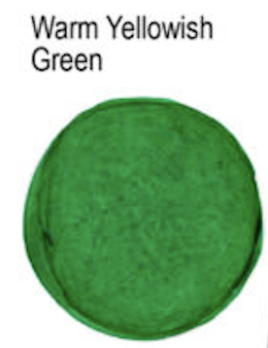
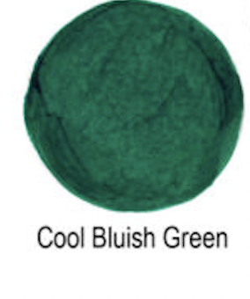


Slide 6
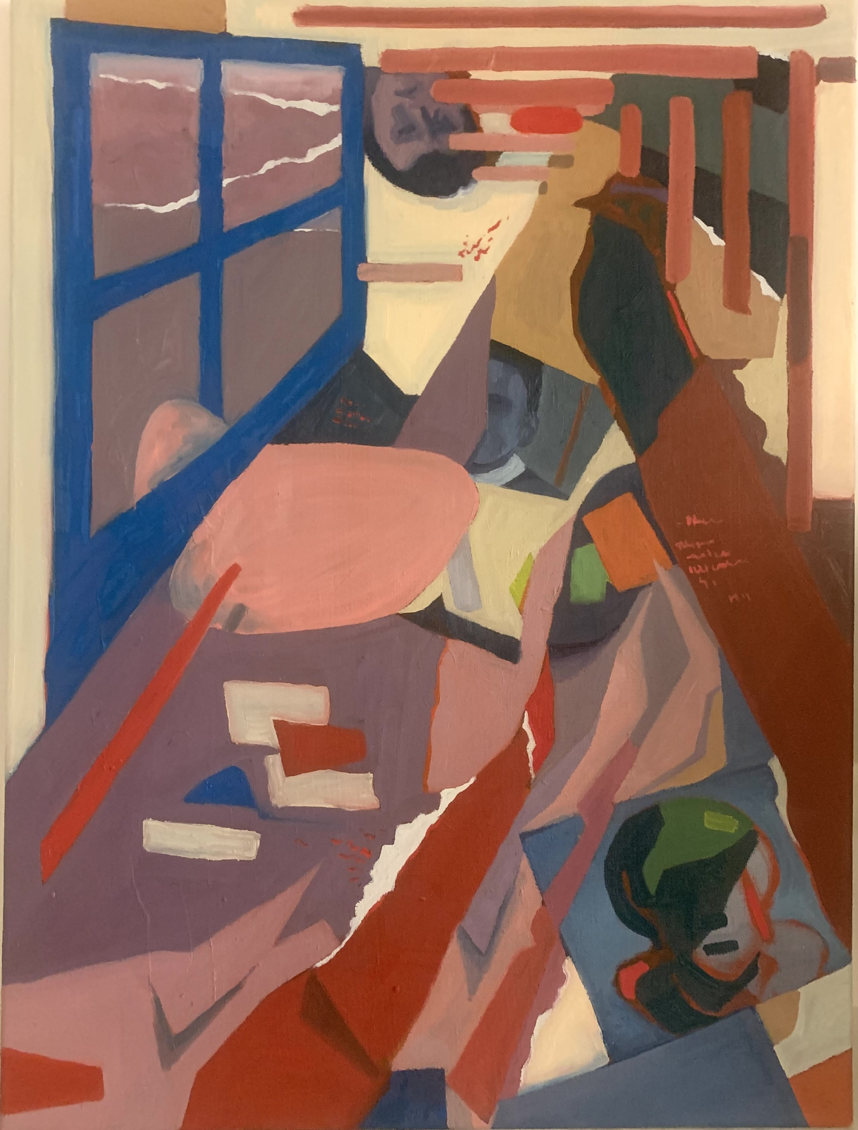
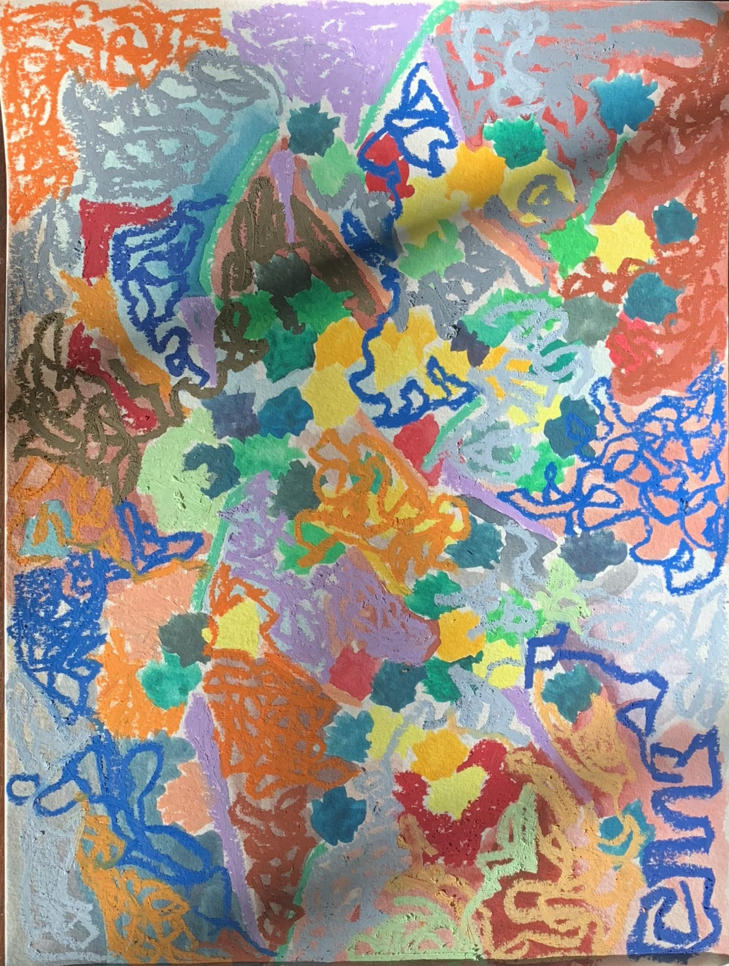
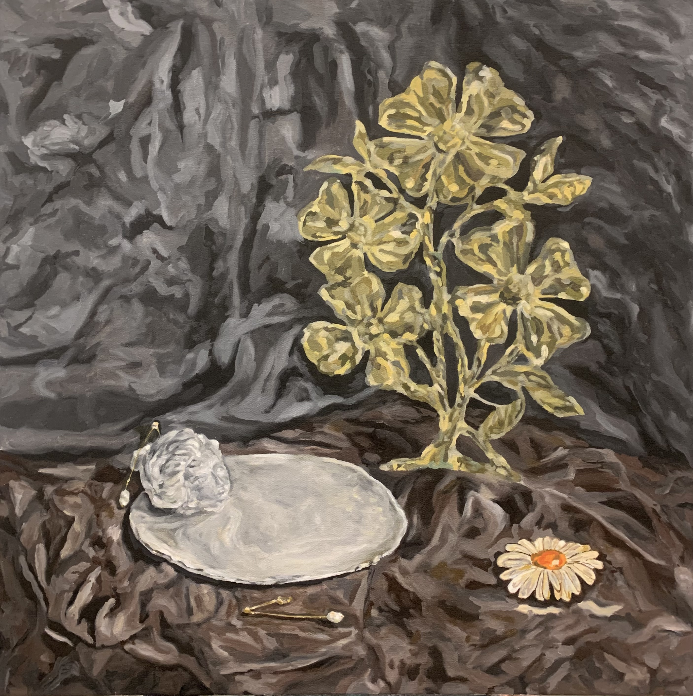
warm
purple to mediate
earth color
cool

Slide 7
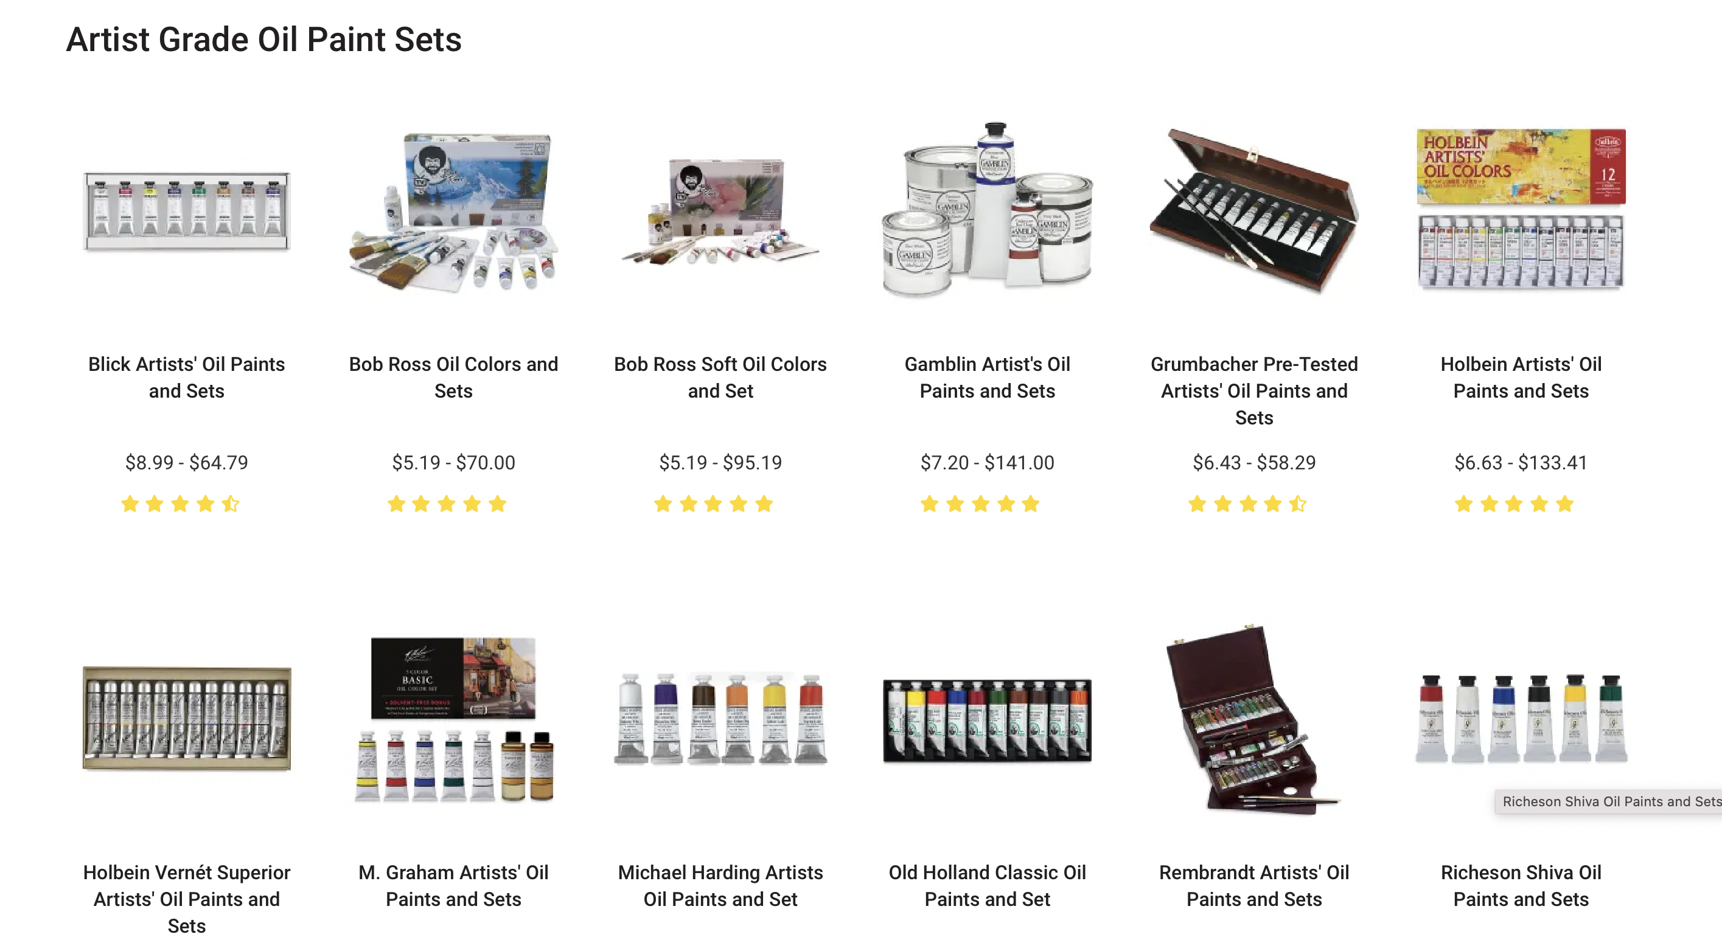

Slide 8
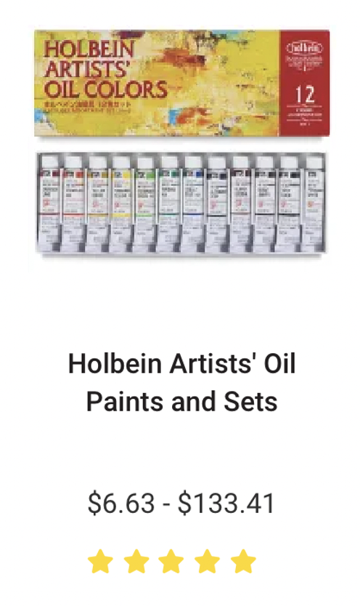
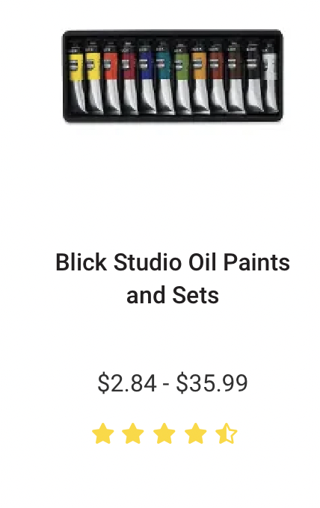
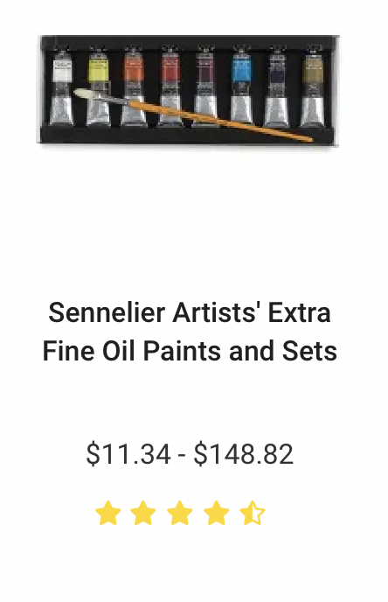
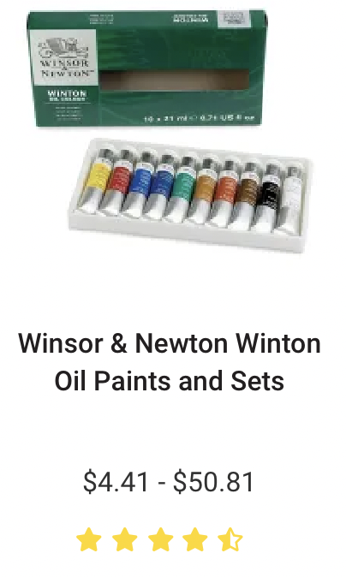
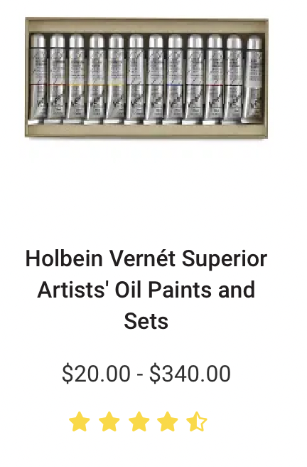

More expansive
Best-sellers

Slide 9
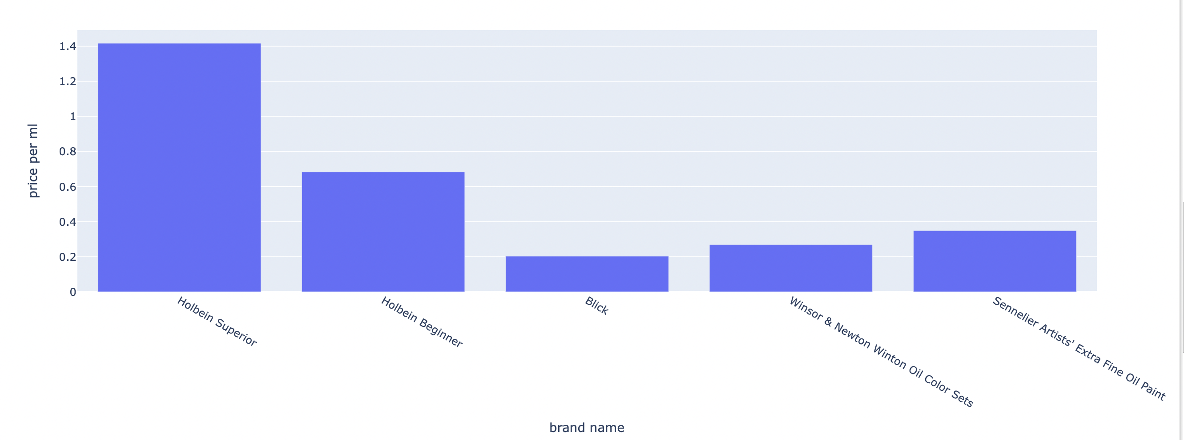
If you buy a set of 10 tubes of 20 ml… A set costs:
283 US dollars 136 US dollars 41 US dollars 54 US dollars 70 US dollars

Slide 10
- The best-sellers should have 1:1:1 in three colors, because they are designed for beginners who need a balanced palette
- The most expensive set should have 1:1:1 in three colors, since they can afford more expensive indigents

Slide 11
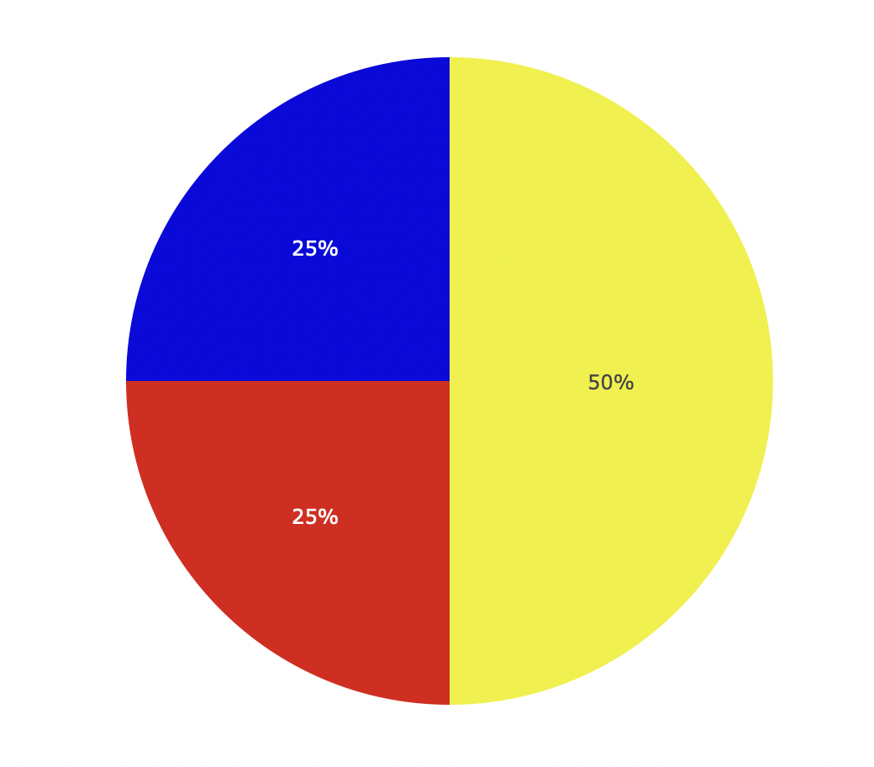
If you buy a set of 10 tubes of 20 ml… A set costs:
283 US dollars 136 US dollars 41 US dollars 54 US dollars 70 US dollars

Slide 12
- The best-sellers should have 1:1:1 in three colors, because they are designed for beginners who need a balanced palette
- The most expensive set should have 1:1:1 in three colors, since they can afford more expensive indigents

Slide 13
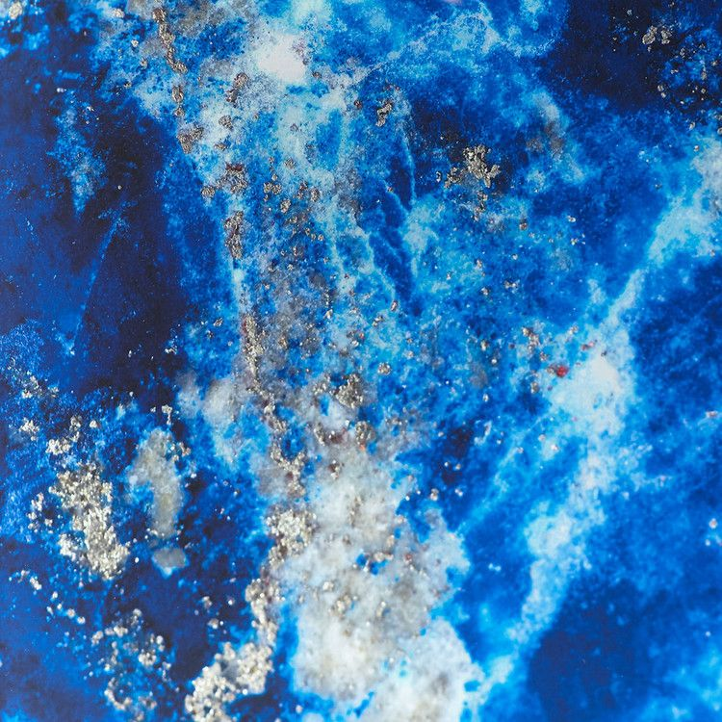
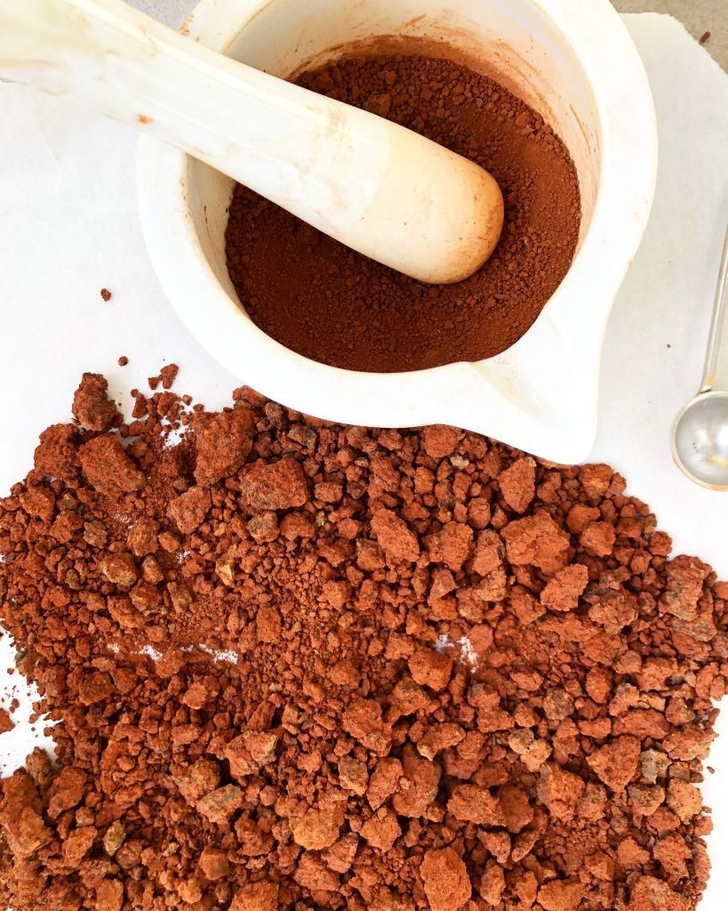
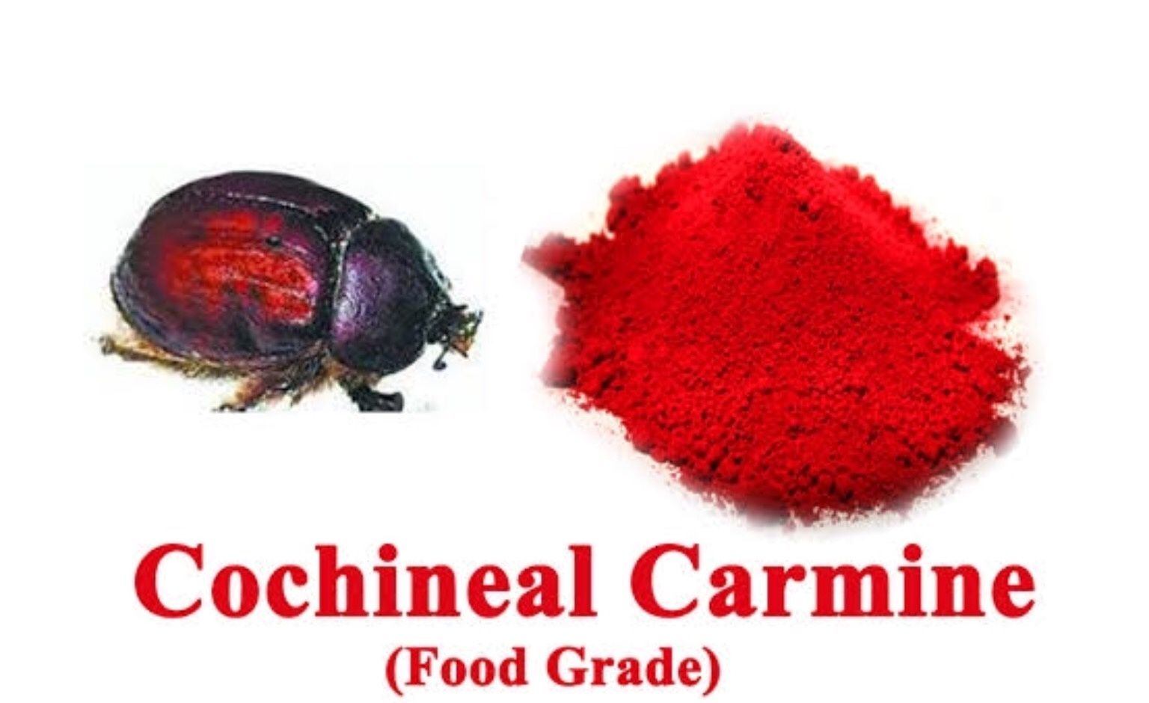
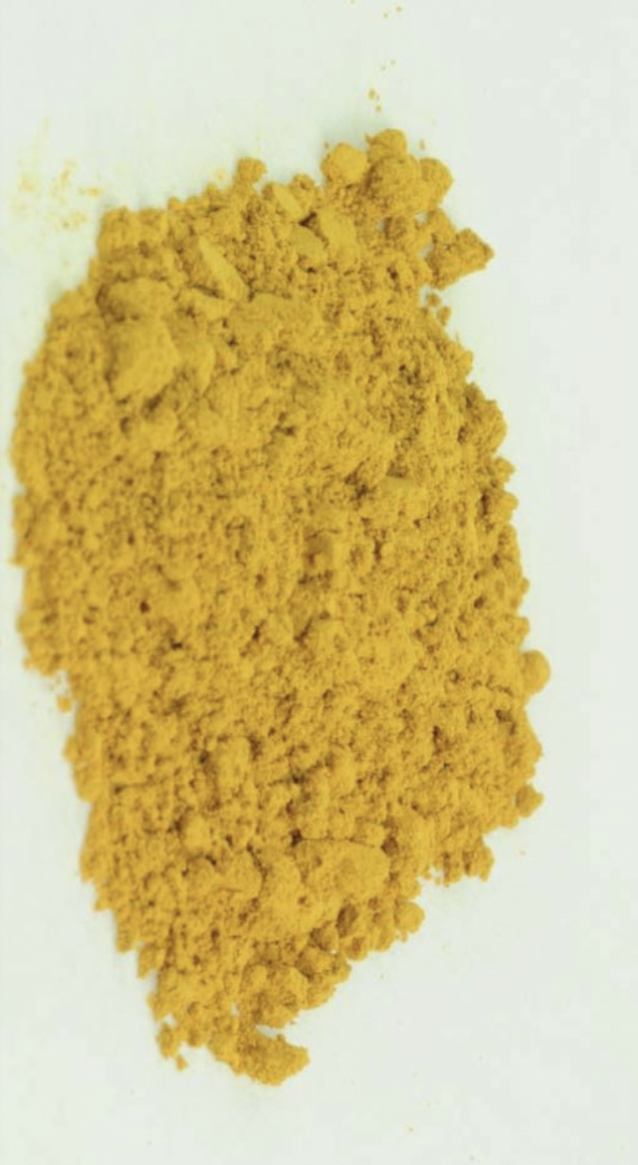
Price:
Earth colors < yellow < red < blue
soil, plant animal urine(imported), clay cochineal insects gemstone(imported), contaminated animal oil

Slide 14





Slide 15
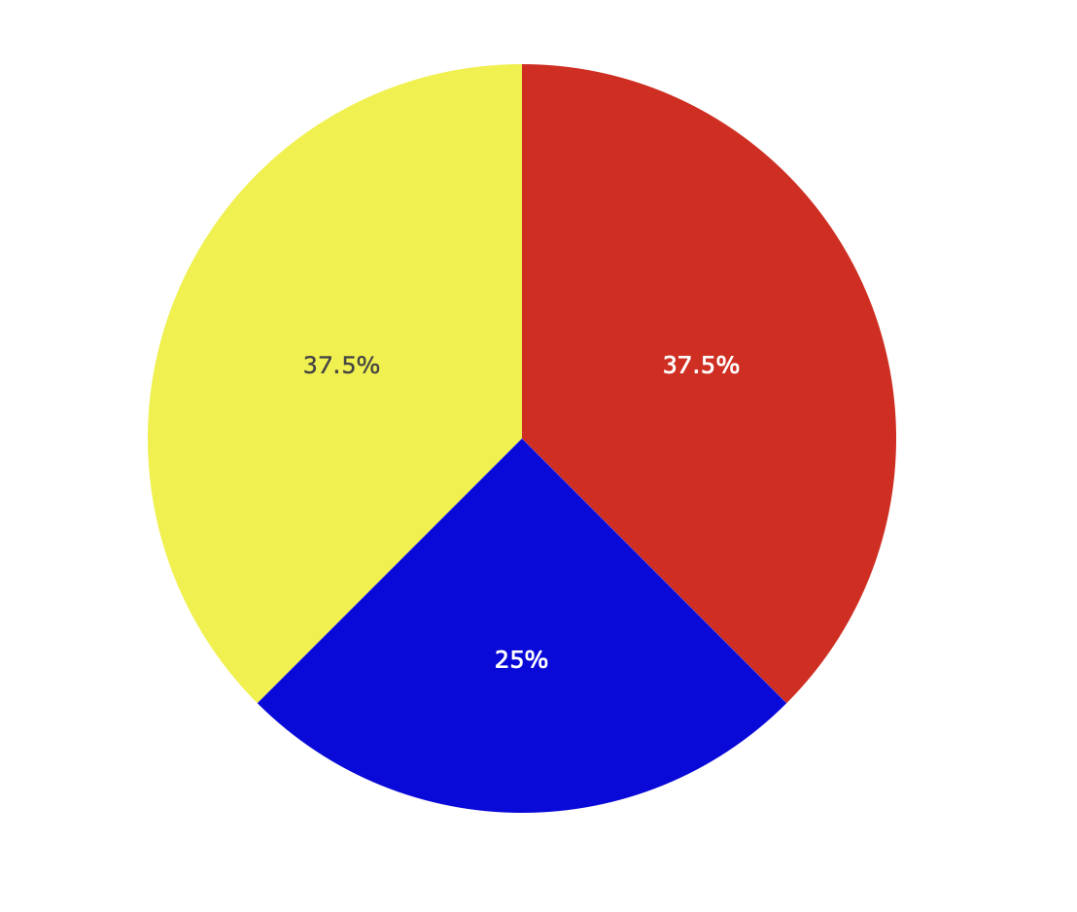
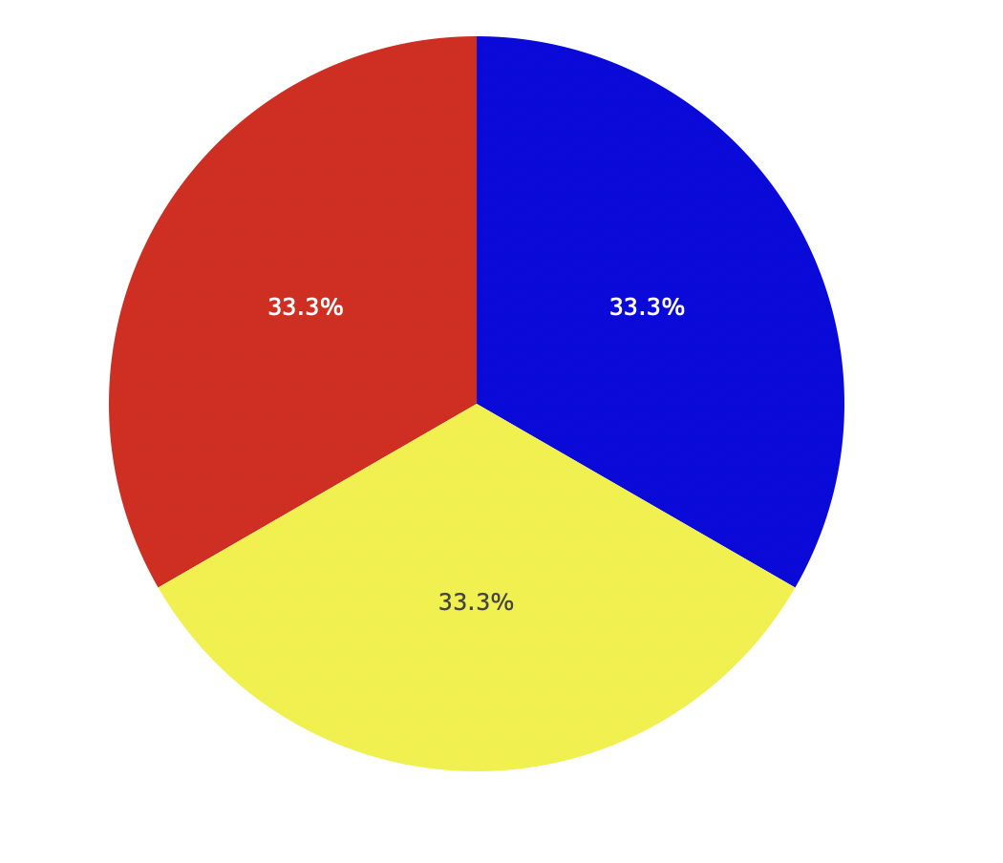
If you buy a set of 10 tubes of 20 ml… A set costs:
283 US dollars 136 US dollars 41 US dollars 54 US dollars 70 US dollars

Slide 16
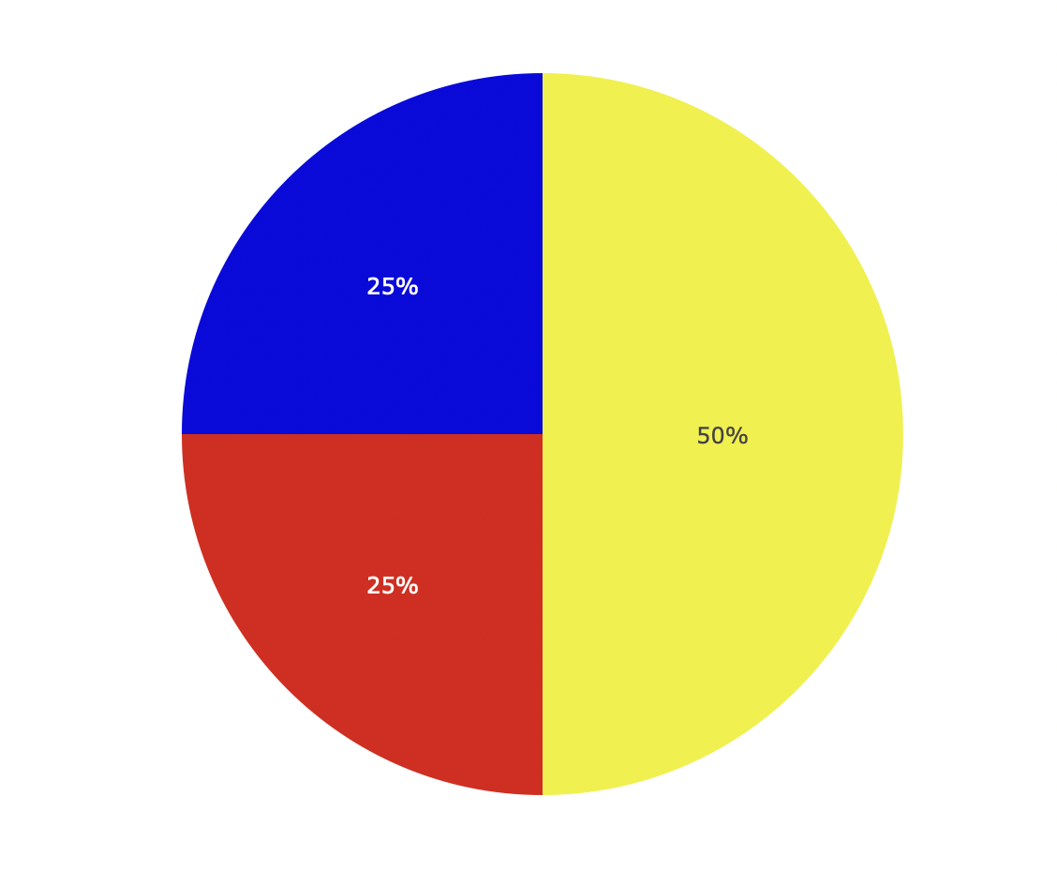
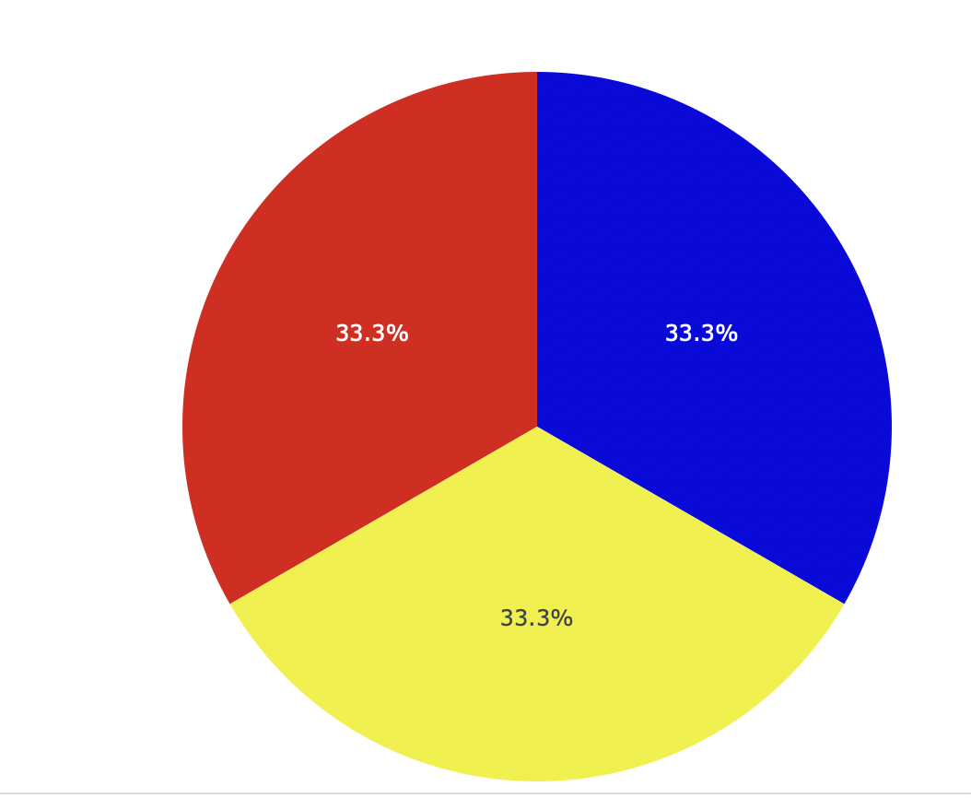
Blick
Holbein Superior
Holbein Beginner
Non-US brand
US brand
Sennelier
Winsor

Slide 17
Price:
Earth colors < yellow < red < blue
soil, plant animal urine(imported), clay cochineal insects gemstone(imported), contaminated animal oil
More expensive set can afford more blue and red
Less expensive set has more earth color to lower the cost

Slide 18
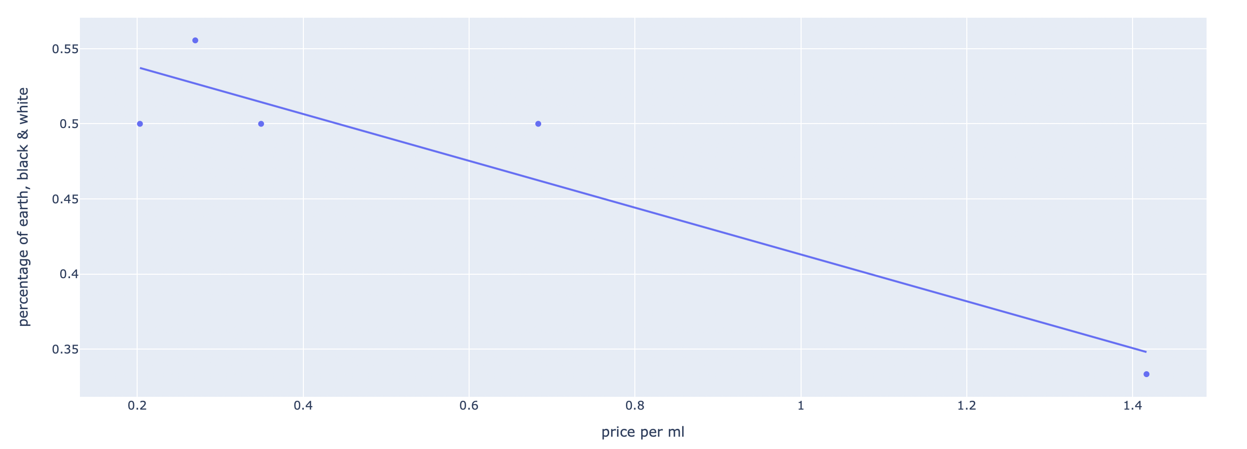

Slide 19
most
expensive
least
expensive
Holbein Superior Holbein Beginner Sennetier Winsor Blick
cool
warm
N
neuter
cool
warm
yellow ochre
N
N
cool
warm
ultramarine

Slide 20
cool
warm
cadmium
vermilion
Essential colors:
cool
warm
titanium
white
yellow ochre
ivory black
lemon / Bismuth
raw sienna
cool
warm
burnt amber
Prussian
ultramarine
budget

